Slide 1

Fraud Detection
Presented by Spring

Slide 2
Agenda
Background
Business Problem Definition
Data Workflow
Modelling Results
Summary/Next Step

Slide 3

Background
Fraud Transaction 4M
Fraud Amount $$$ 470M
1000$ transaction has 58.3 cent fraud
(Fraud Statistics 2020)

Slide 4

Business Problem Definition
“ How can we CAPTURE the fraud transaction and STOP it immediately ??? ”
-Business Question
“ Which data model can PREDICT fraud transaction accurately ??? ”
-Data Question

Slide 5



Data Workflow
Data Acquisition
Feature
Engineering
Modelling
Validation
Testing
EDA

Slide 6
Dataset Summary
284k rows * 31 cols (30 features, 1 class)
Unbalanced Class Data (99.83% Non Fraud vs. 0.17% Fraud)
Limited meaningful Features names (v1~v28, time, amount)

Slide 7
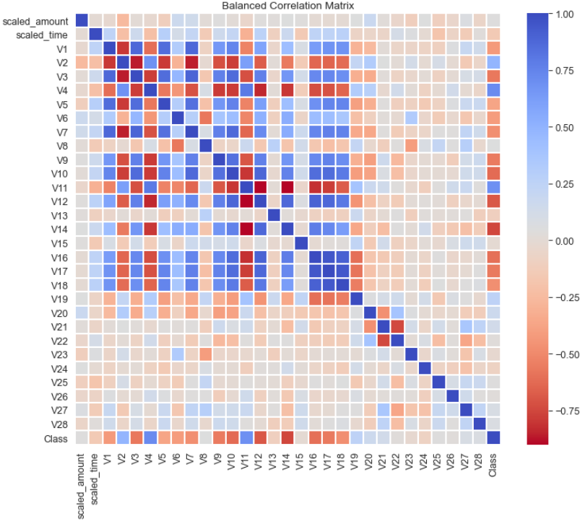
Features Correlation Matrix
Top Positive Correlated features
V2, V4, V11, V19
Top Negative Correlated features
V10, V12, V14, V17

Slide 8
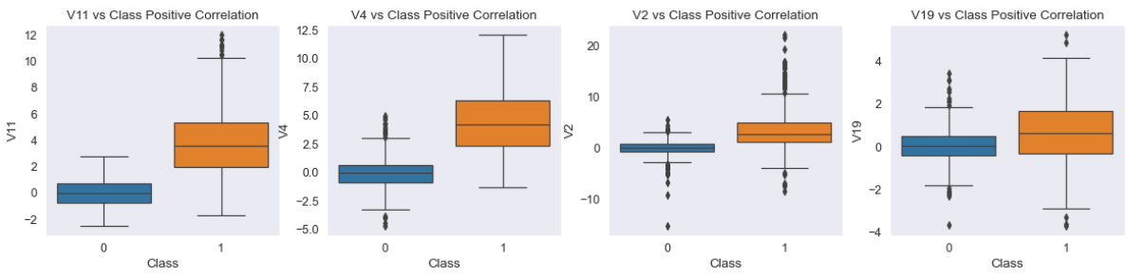
EDA
V11 & V4 trend to perform more differently between fraud and non-fraud transaction
(1: Fraud | 0: Non-Fraud)

Slide 9
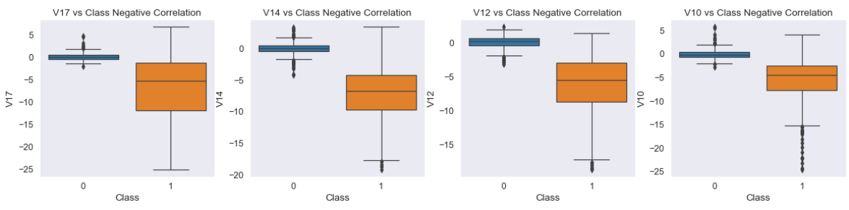
EDA
V10 & V12 & V14 trend to perform more differently between fraud and non-fraud transaction
(1: Fraud | 0: Non-Fraud)

Slide 10

Modelling Testing Results
Model | Accuracy | Recall | F1-Score
Logistic Regression | 0.93 | 0.92 | 0.93
K Nearest Neighbours | 0.94 | 0.90 | 0.94
SVC Linear | 0.94 | 0.93 | 0.94
Decision Tree | 0.92 | 0.87 | 0.92
Naïve Bayes | 0.90 | 0.84 | 0.90
Stacking Ensemble | 0.95 | 0.93 | 0.95
Stacking Ensemble perform best according to Accuracy/Recall/F1-score

Slide 11
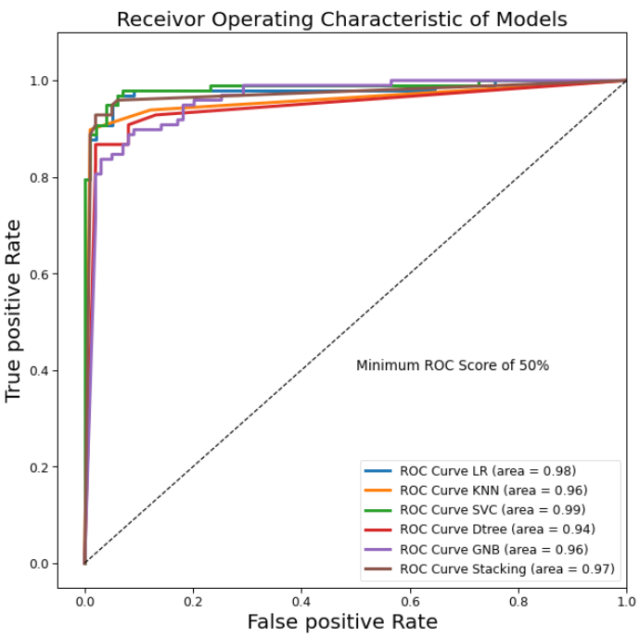
Receiver Operating Characteristic
AUC Score:
Support Vector Machine 0.99
Logistic Regression 0.98
Stacking Ensemble 0.97

Slide 12
Summary
All models perform consistently on accuracy on training and test with <1% variance
Support vector machine is the 1st choice based on AUC of ROC
Stacking ensemble model is the 2nd choice based on best accuracy/recall/f1-scores

Slide 13
Next Step
All 30 features are included for modelling, so feature selection can be considered to reduce overfit
Only under-sampling technic is applied, over-sampling can be applied for further explored
Neural network and Boosting algorithms can be explored for better overall model performance

Slide 14

THANK YOU! Question?

Slide 15
Reference
Dataset quote from Kaggle https://www.kaggle.com/mlg-ulb/creditcardfraud
Australian Fraud data quote from www.auspaynet.com.au

